Slide 1

AI Reliability in Industrial Safety A Case Study with ABB IRB 1200 and Intel RealSense D415
Supervisor: Mathias Verbeke
Supervisor: Matthias De Ryck
Iñigo Aduna Alonso
Academic year 2023 – 2024
Master of AI in Business and Industry

Slide 2
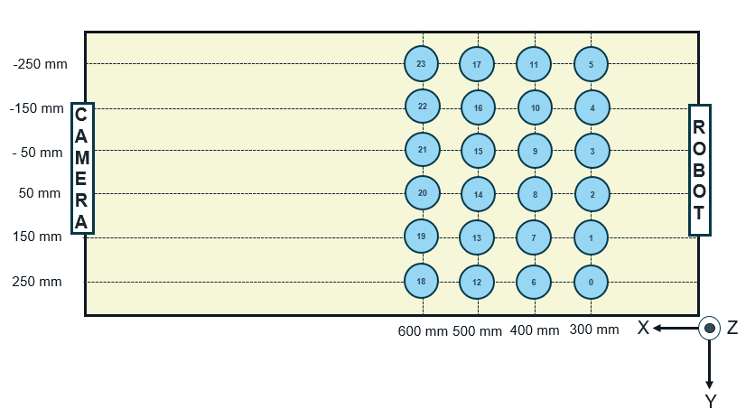
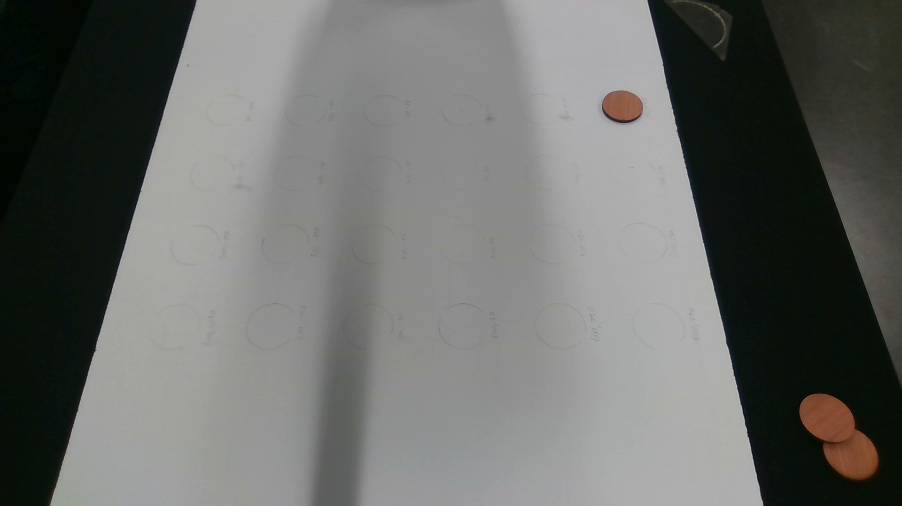
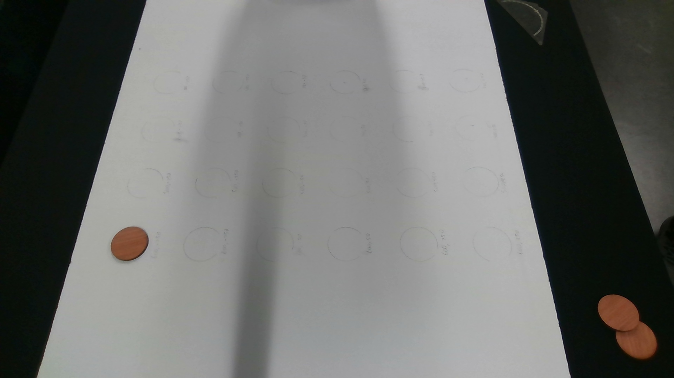
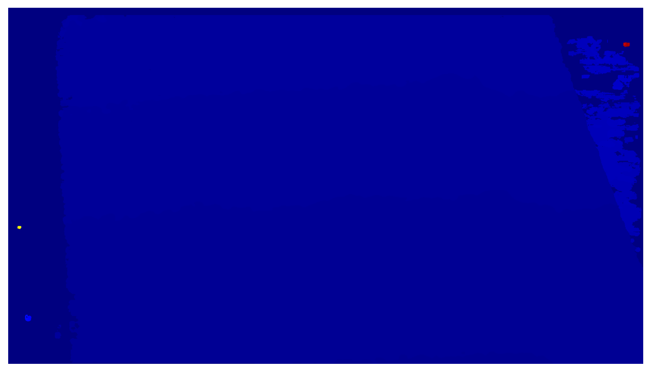
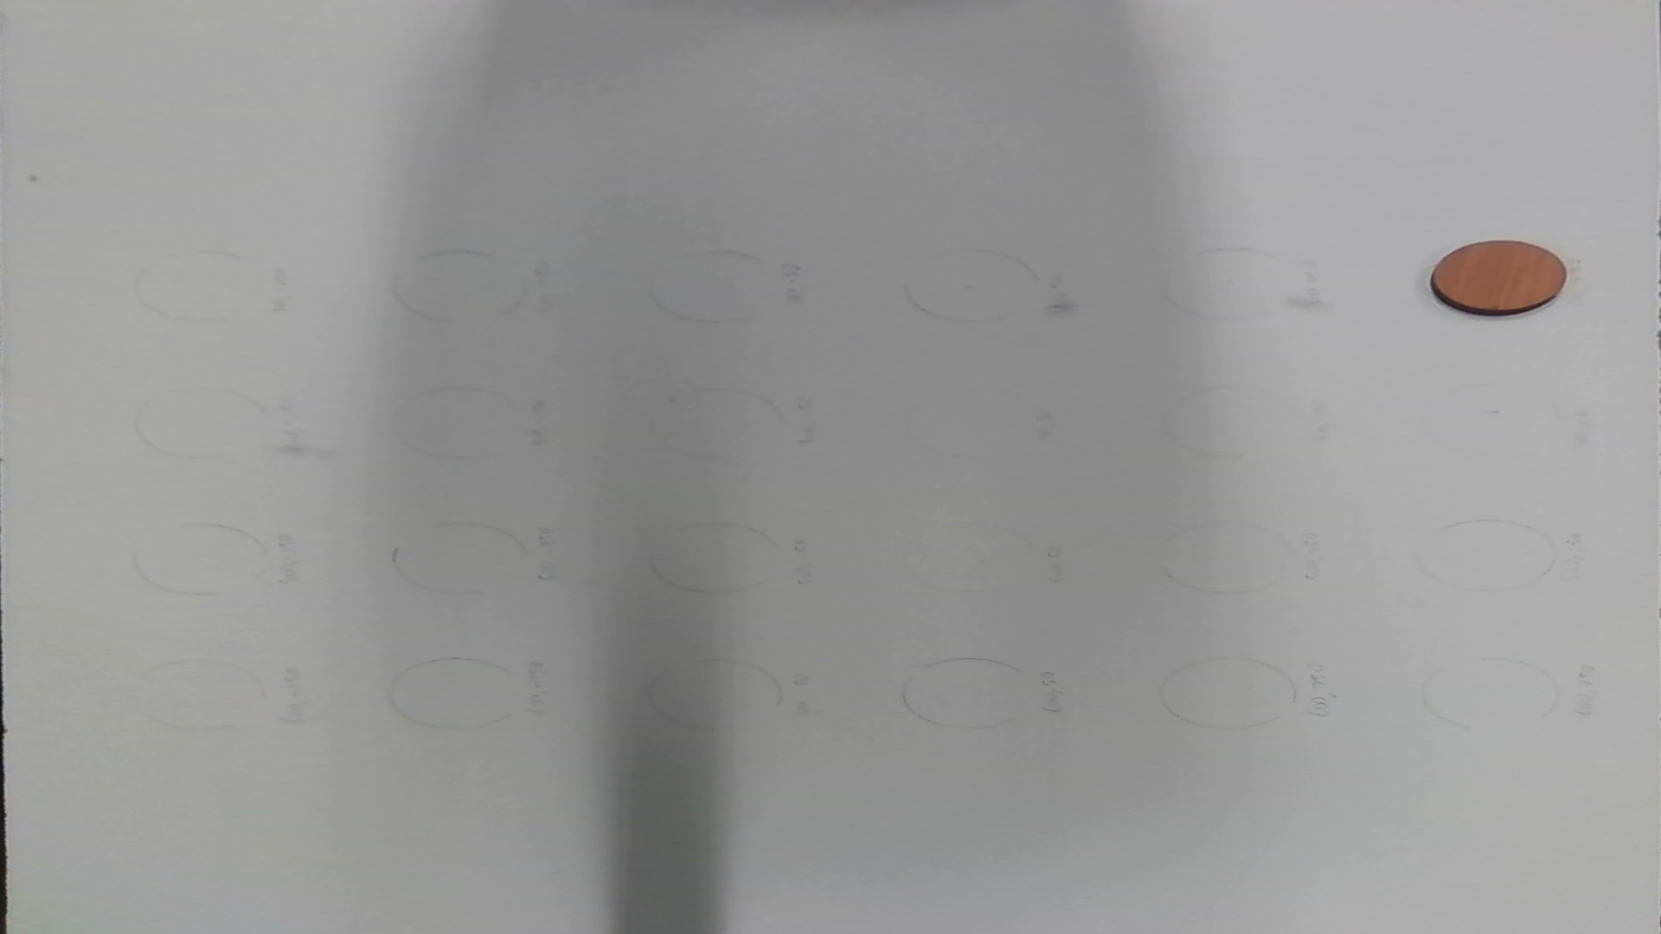
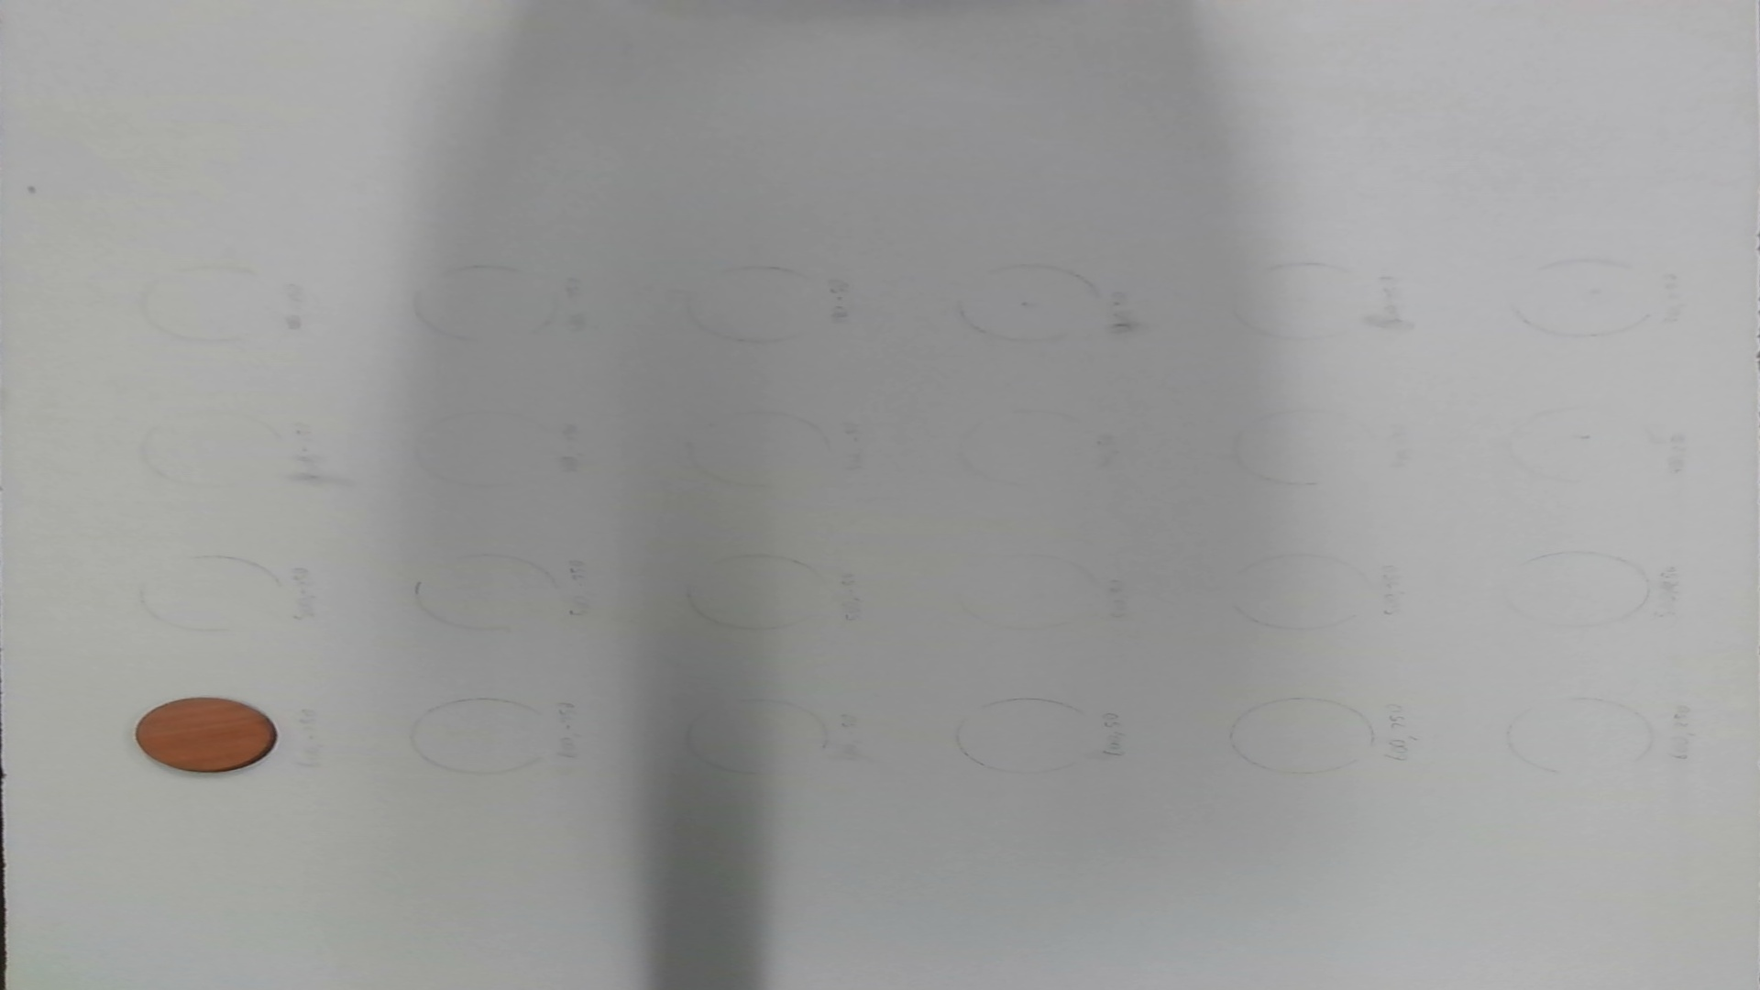
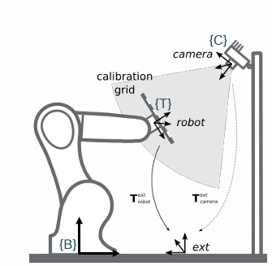


State of the Art
1.- Raw Images:
2.- Warped Images (Distortion correction + M):
3.- Masks
Image_0.jpg
Image_23.jpg

Slide 3
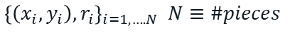

State of the Art
3.- Masks
Image_0.jpg
Image_23.jpg
4.- Get object Pixel
$${\left\{\left(x_{i},y_{i}\right),r_{i}\right\}}_{i=1,….N} N≡\#pieces$$
5.- 2D → 3D
$${\left\{\left(x_{i},y_{i},z_{i}\right) \right\}}_{i=1,….N}$$
6.-Transformation camera coordinates to robot base coordinates $T_{BC}$
$${\left\{\left({\hat{x}}_{i},{\hat{y}}_{i},{\hat{z}}_{i}\right) \right\}}_{i=1,….N}$$

Slide 4
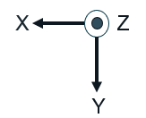
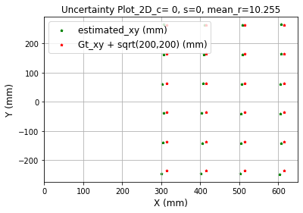



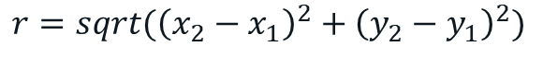

First approach
1.- Tool Correction: $\left(C_{x},C_{y}\right)=\left(sqrt\left(200\right),sqrt\left(200\right)\right)$
$$EE≡End Effector$$
W
$$W≡Wrist (Suction device)$$
$$C_{y}$$
$$C_{x}$$
EE
Uncertainty$: Euclidean Distance$
$$r=sqrt({\left(x_{2}−x_{1}\right)}^{2}+{\left(y_{2}−y_{1}\right)}^{2})$$

Slide 5
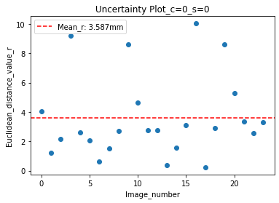
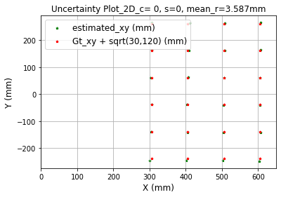
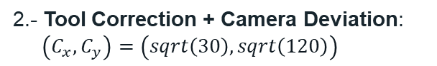




Modifications
1.- Tool Correction: $\left(C_{x},C_{y}\right)=\left(sqrt\left(200\right),sqrt\left(200\right)\right)$
2.- Tool Correction + Camera Deviation:
$\left(C_{x},C_{y}\right)=\left(sqrt\left(30\right),sqrt\left(120\right)\right)$
$$EE≡End Effector$$
EE
$$F ≡ Flange$$
$$C_{y}$$
$$C_{x}$$
F

Slide 6
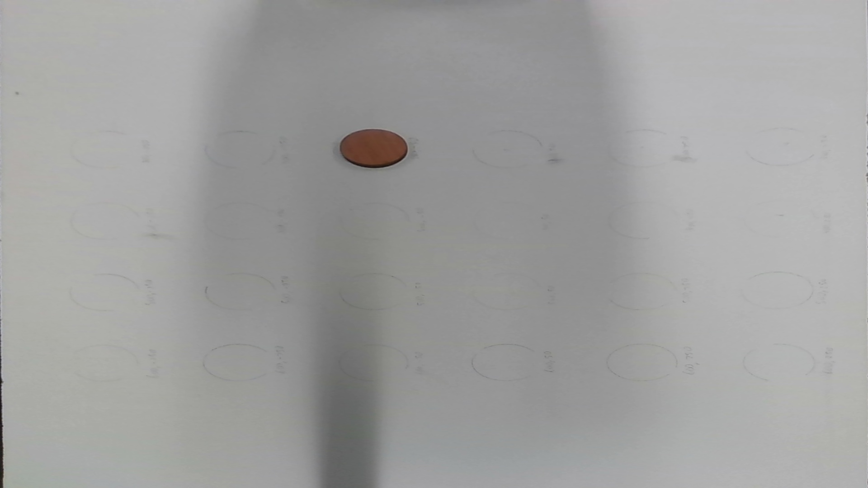

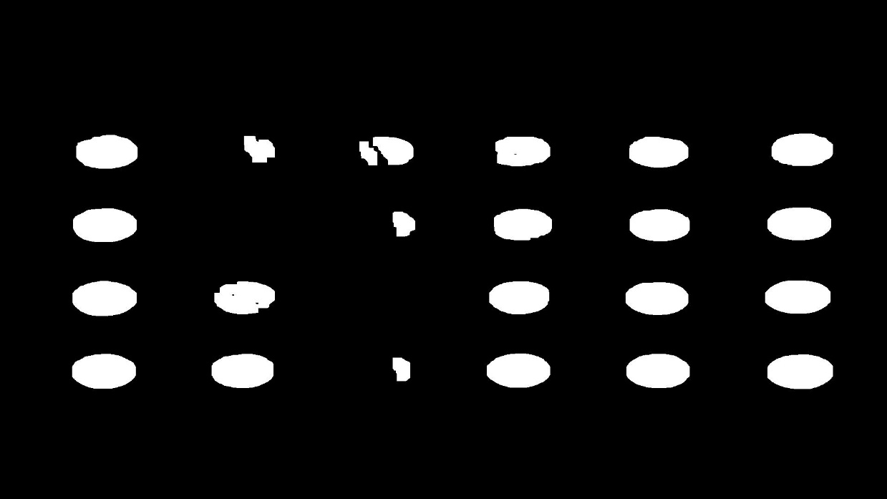
Modifications
Previous Mask (H=Hue, S=Saturation, V=Value) 1.1 Load HSV calibration parameters.
1.2 Apply Gaussian Blur for image smoothing
1.3 Convert image to HSV for color-based
segmentation.
1.4 Create mask using HSV calibration values
1.5 Apply opening (erosión+dilatation) to remove
noise/small objects
Advantages.
Effective for color segmentation
Disadvantages
Sensitive to brightness changes (e.g., Sadows)

Slide 7
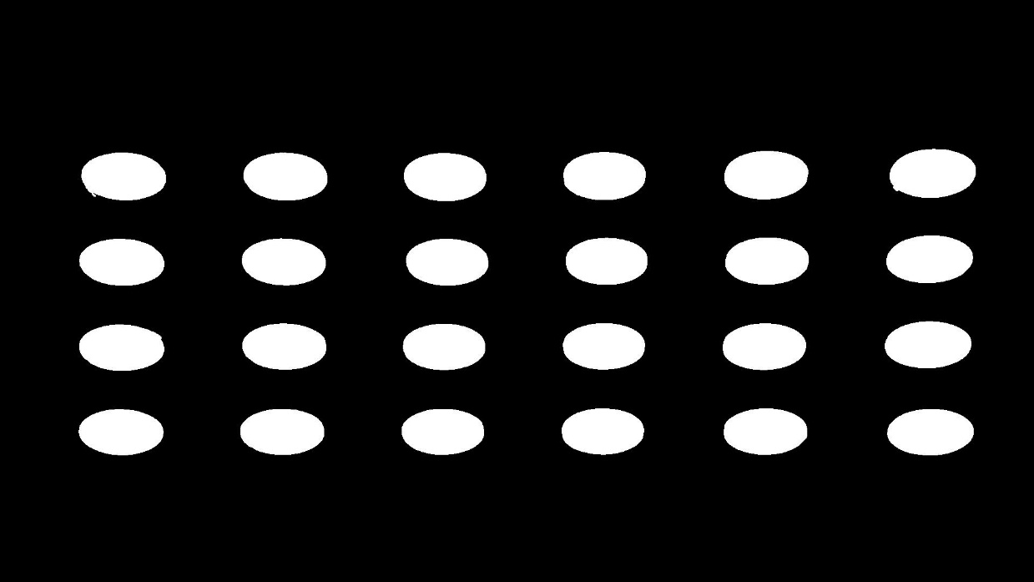
Modifications
New Mask (Grayscale) 1.1 Grayscale Conversion to reduce complexity.
1.2 Apply Gaussian Blur for image smoothing
1.3 Edge Detection with Canny Algorithm
1.3.1 Identify edges by finding intensity
gradients.
1.3.2 Filter out weak edges, keeping
strong ones.
1.4 Contour Detection to find and outline distinct
shapes.
1.5 Mask Creation
Advantages:
Objects where colour isn´t distinctive, but shape is.
Disadvantages:
Information loss when converting to grayscale.

Slide 8
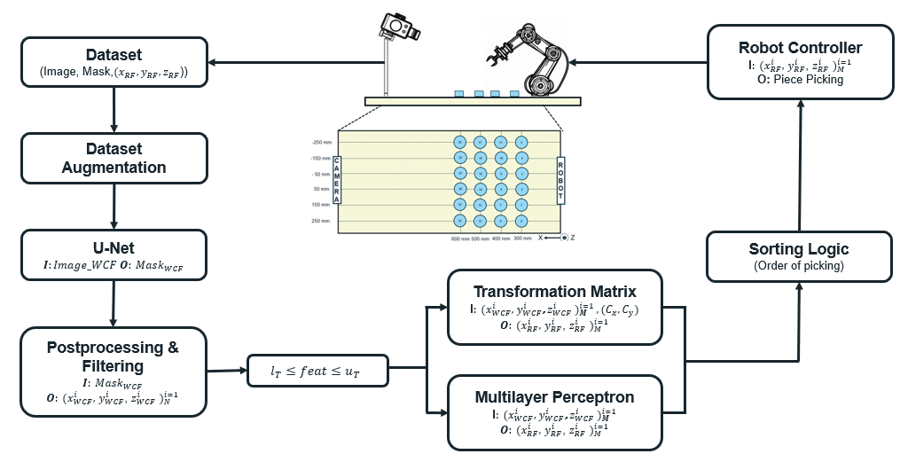
Master´s Thesis Workflow

Slide 9

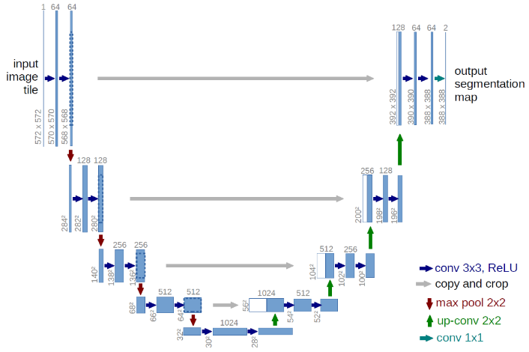

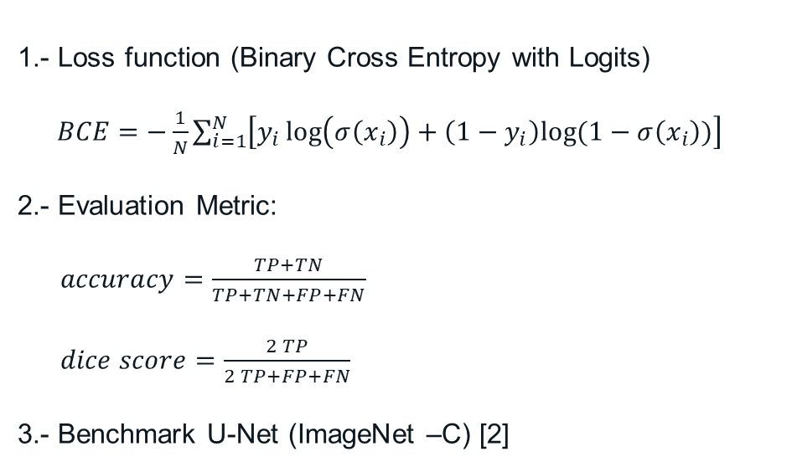
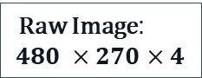
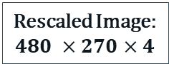
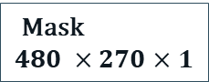
U-Net [1]
Human Supervision
Raw Image:
$$480 ×270×4$$
$$÷4$$
Rescaled Image:
$$480 ×270×4$$
U-Net
Mask
$$480 ×270×1$$
1.- Loss function (Binary Cross Entropy with Logits)
$BCE=−\frac{1}{N}\sum_{i=1}^{N}{\left[y_{i}\log\left(σ\left(x_{i}\right)\right)+\left(1−y_{i}\right)log⁡(1−σ\left(x_{i}\right))\right]}$
2.- Evaluation Metric:
$accuracy=\frac{TP+TN}{TP+TN+FP+FN}$
$dice score=\frac{2 TP}{2 TP+FP+FN}$
3.- Benchmark U-Net (ImageNet –C) [2]

Slide 10
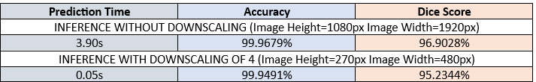
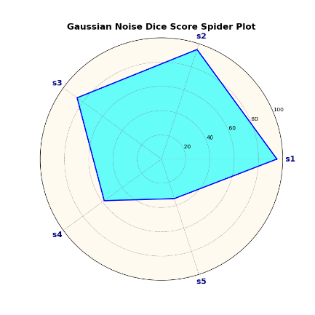
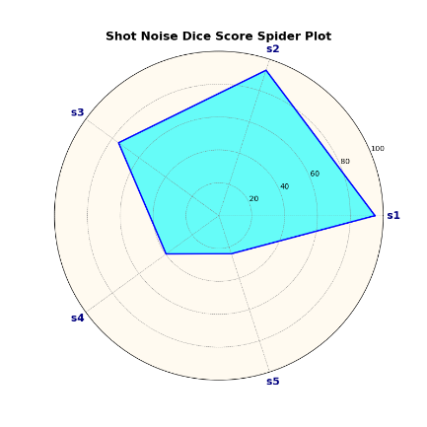
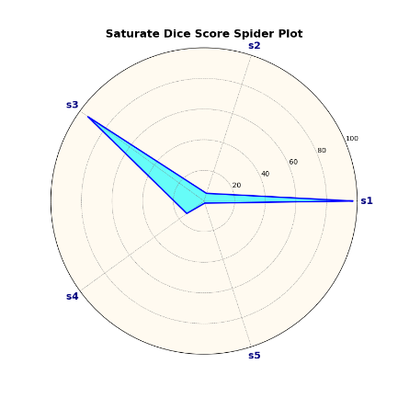
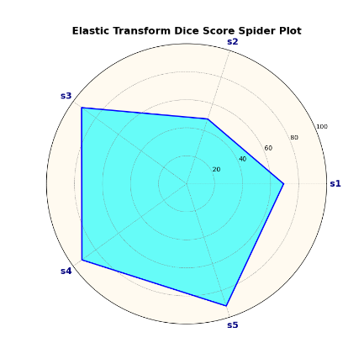
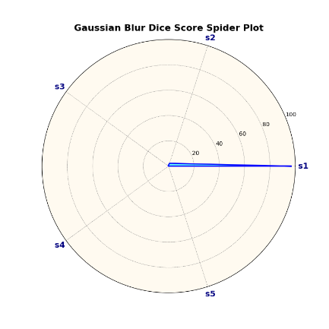
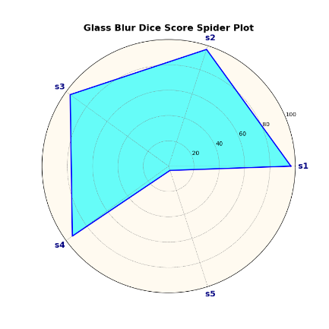
U-Net [1]
Accuracy = 99.94%
Dice Score = 95.2344%
Future study:
1.- Dice Score Calculation
2.- Add Depth to Image (Currently RGB)
3.- Benchmark on Imagenet-C
3.1 Evaluate Robustness to Corruption
3.2 Compare performance Metrics
4.- Dataset Augmentation Effect (Imagenet-C)
5.- Hyperparameter Sweep Study

Slide 11
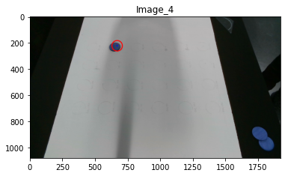

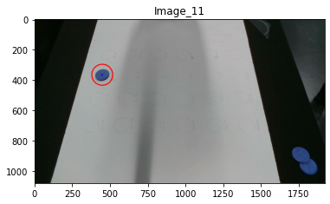
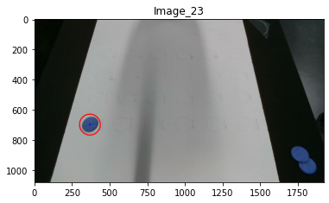

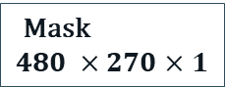
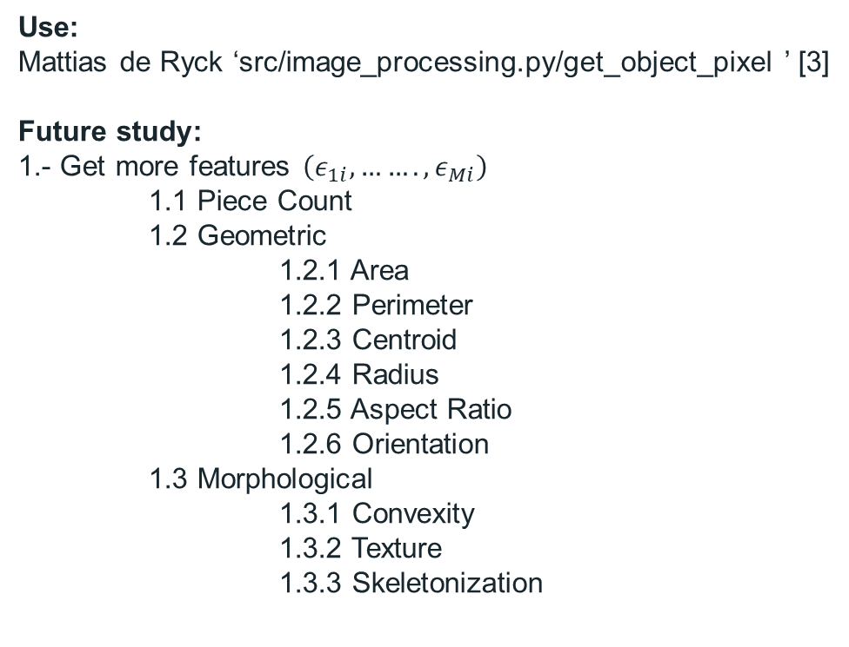
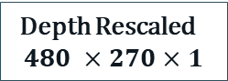
Post Processing
Mask
$$480 ×270×1$$
Post Proc
$${\left\{\left(x_{i},y_{i},z_{i}, ε_{1i},ε_{2i},ε_{3i},…..ε_{Mi}\right)\right\}}_{i=1,…N}$$
Use:
Mattias de Ryck ‘src/image_processing.py/get_object_pixel ’ [3]
Future study:
1.- Get more features $\left(ε_{1i},…….,ε_{Mi}\right)$
1.1 Piece Count
1.2 Geometric
1.2.1 Area
1.2.2 Perimeter
1.2.3 Centroid
1.2.4 Radius
1.2.5 Aspect Ratio
1.2.6 Orientation
1.3 Morphological
1.3.1 Convexity
1.3.2 Texture
1.3.3 Skeletonization
Depth Rescaled
$$480 ×270×1$$

Slide 12
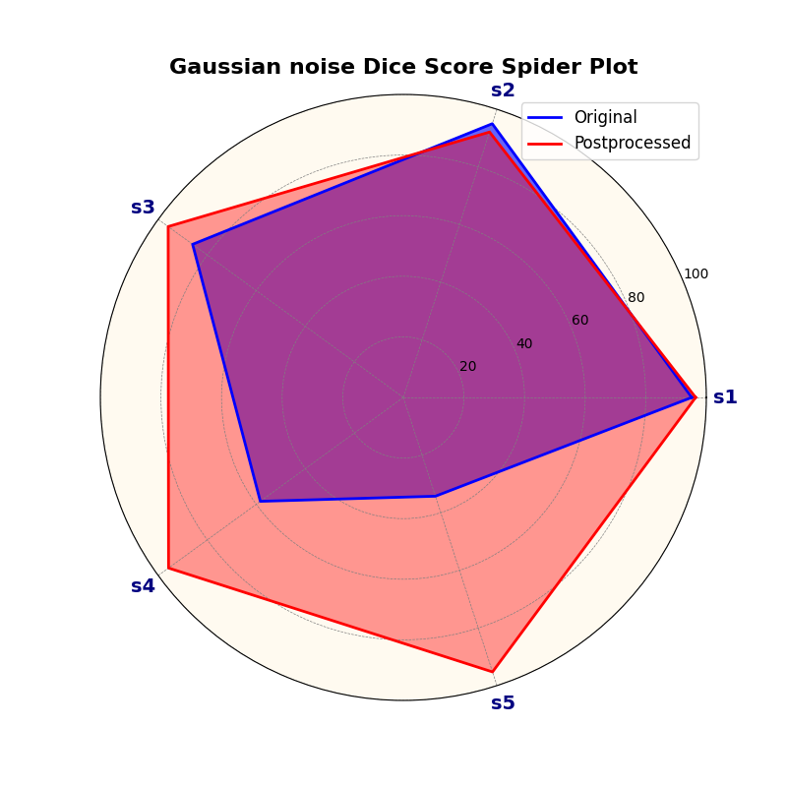
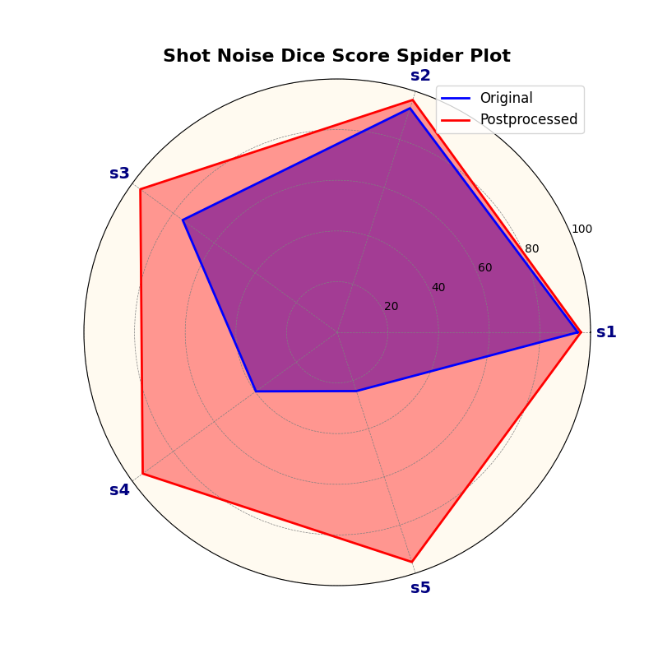
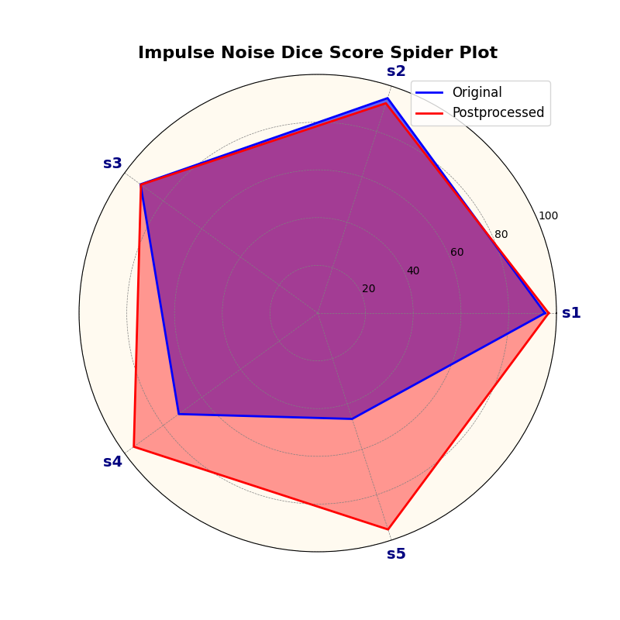
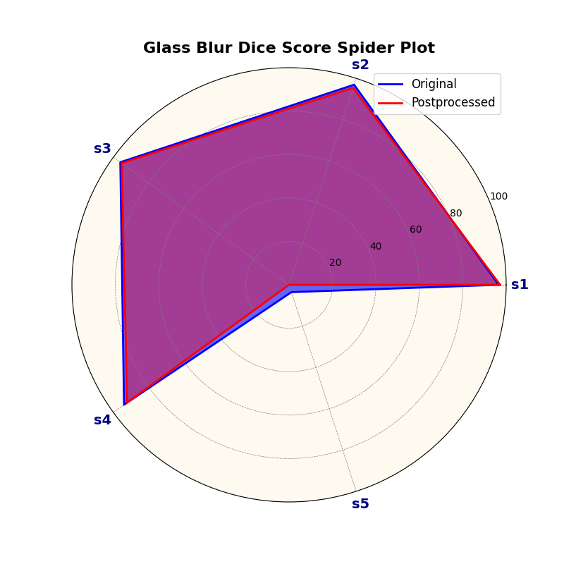
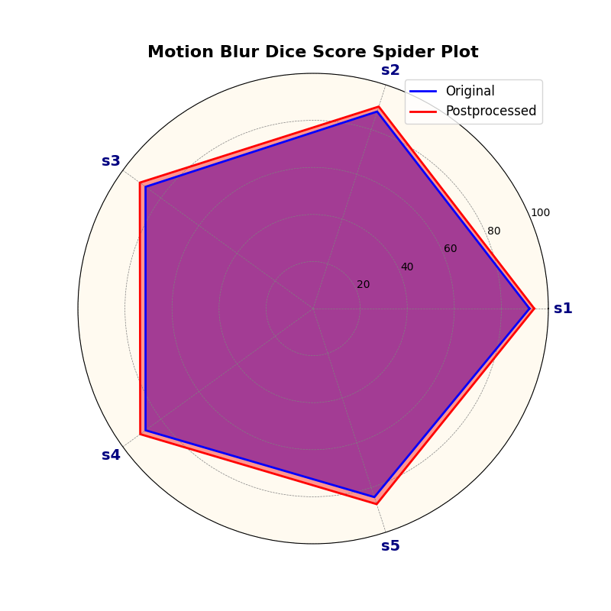
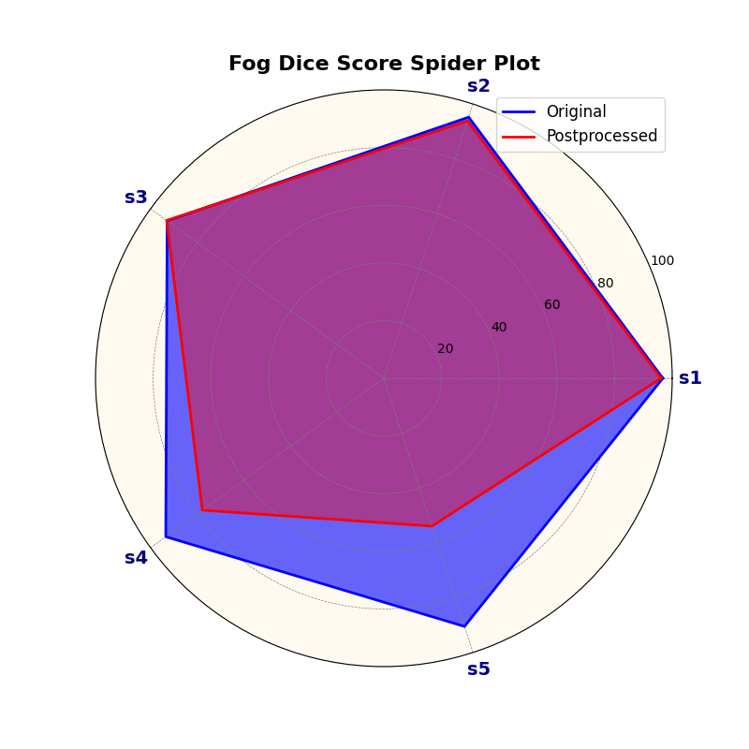
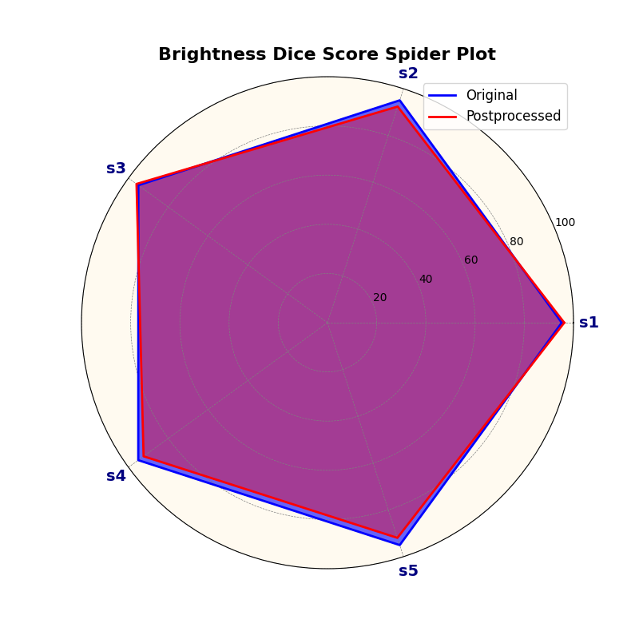
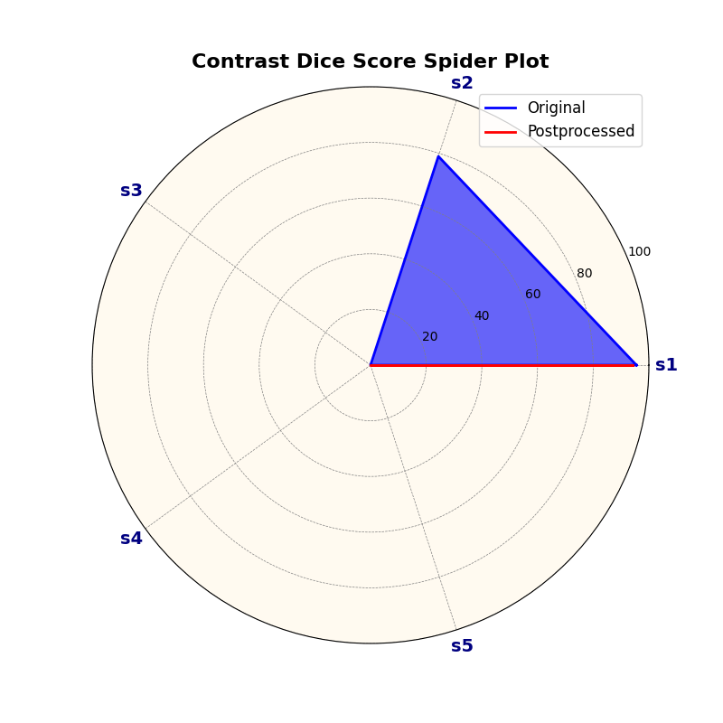
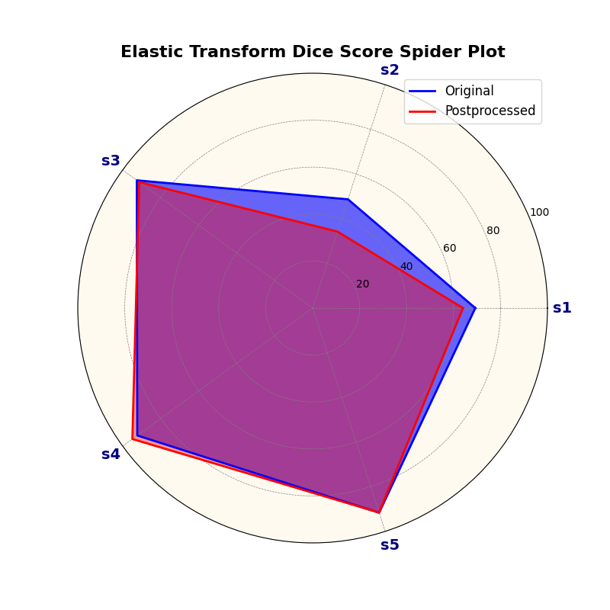
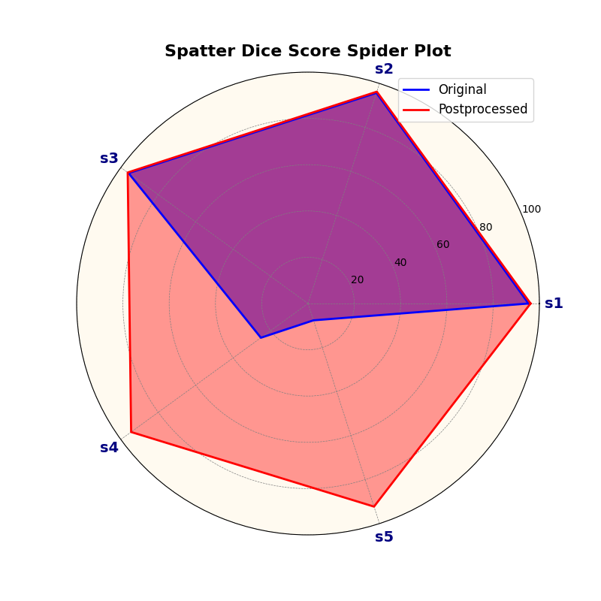
Results Postprocessing

Slide 13
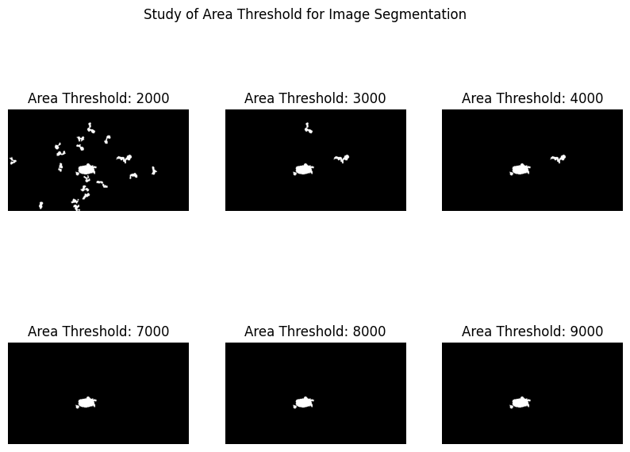
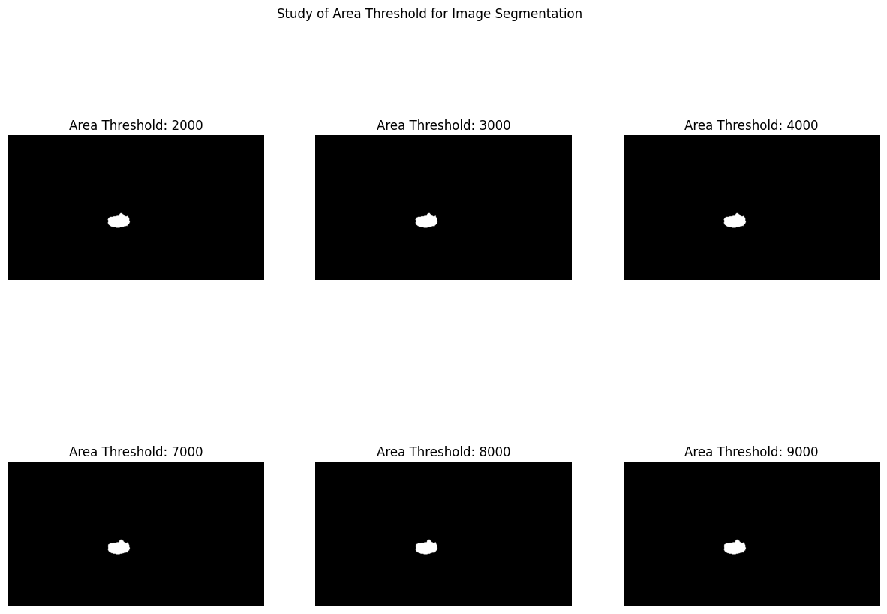
Filtering

Slide 14
Bibliography
[1] A. F. Frangi, J. Hornegger, N. Navab, and W. M. Wells, "U-Net: Convolutional Networks for Biomedical Image Segmentation," in Lecture Notes in Computer Science, vol. 9351, pp. 234-241, Springer International Publishing AG, Switzerland, 2015, ISBN: 9783319245737.
[2] D. Hendrycks and T. Dietterich, "Benchmarking Neural Network Robustness to Common Corruptions and Perturbations," 2019.
[3] M. De Ryck, "Robot Demonstrator Code," 2023, GitHub repository. Available: https://github.com/MatthiasDR96/robot_demonstrator.git.
[4] Chih-Hong, Cheng, Nührenberg, Georg, and Yasuoka, Hirotoshi. "Runtime Monitoring Neuron Activation Patterns." arXiv.org, 2018. ISSN 2331-8422.
[5] Lakshminarayanan, B., Pritzel, A., & Blundell, C. (2016). Simple and Scalable Predictive Uncertainty Estimation using Deep Ensembles. arXiv.org.
[6] Sahu, Amit; Vállez, Noelia; Rodríguez-Bobada, Rosana; Alhaddad, Mohamad; Moured, Omar; Neugschwandtner, Georg. "Application of the Neural Network Dependability Kit in Real-World Environments." arXiv (Cornell University), 2020. ISSN: 2331-8422.

Slide 15


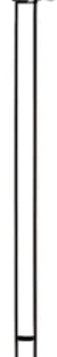
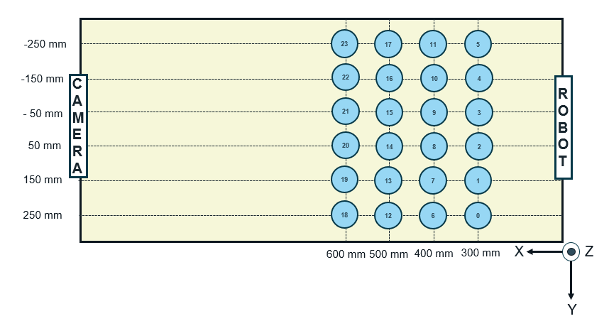
Drawing:

Slide 16
-250 mm
23
17
11
5
-150 mm
22
16
10
4
CAMERA
ROBOT
- 50 mm
21
15
9
3
50 mm
20
14
8
2
150 mm
19
13
7
1
250 mm
18
12
6
0
600 mm
500 mm
400 mm
300 mm
X
..
Z
Y

Slide 17








Robot Controller
I$: (x_{RF}^{i},$ $y_{RF}^{i}$, $z_{RF}^{i}$ $)_{M}^{i=1}$
O: Piece Picking
Dataset
(Image, Mask,$(x_{RF},y_{RF},z_{RF}$))
Dataset
Augmentation
U-Net
$I:Image_WCF O: Mask_{WCF}$
Sorting Logic
(Order of picking)
Transformation Matrix
I$: (x_{WCF}^{i},$ $y_{WCF}^{i}$, $z_{WCF}^{i}$ $)_{M}^{i=1 }, (C_{x}, C_{y})$
$O: (x_{RF}^{i},$ $y_{RF}^{i}$, $z_{RF}^{i}$ $)_{M}^{i=1}$
Postprocessing & Filtering
$$I: {Mask}_{WCF}$$
$O: (x_{WCF}^{i},$ $y_{WCF}^{i}$, $z_{WCF}^{i}$ $)_{N}^{i=1}$
$$l_{T}≤feat≤u_{T}$$
Multilayer Perceptron
I$: (x_{WCF}^{i},$ $y_{WCF}^{i}$, $z_{WCF}^{i}$ $)_{M}^{i=1}$
$O: (x_{RF}^{i},$ $y_{RF}^{i}$, $z_{RF}^{i}$ $)_{M}^{i=1}$

Slide 18



$$EE={\left(x+c_{X},y+c_{Y},z+C_{z}\right)}_{RF}$$
$$F = {\left(x,y,z\right)}_{RF}$$
EE
$$C_{y}$$
F
$$C_{x}$$

